Slide 1
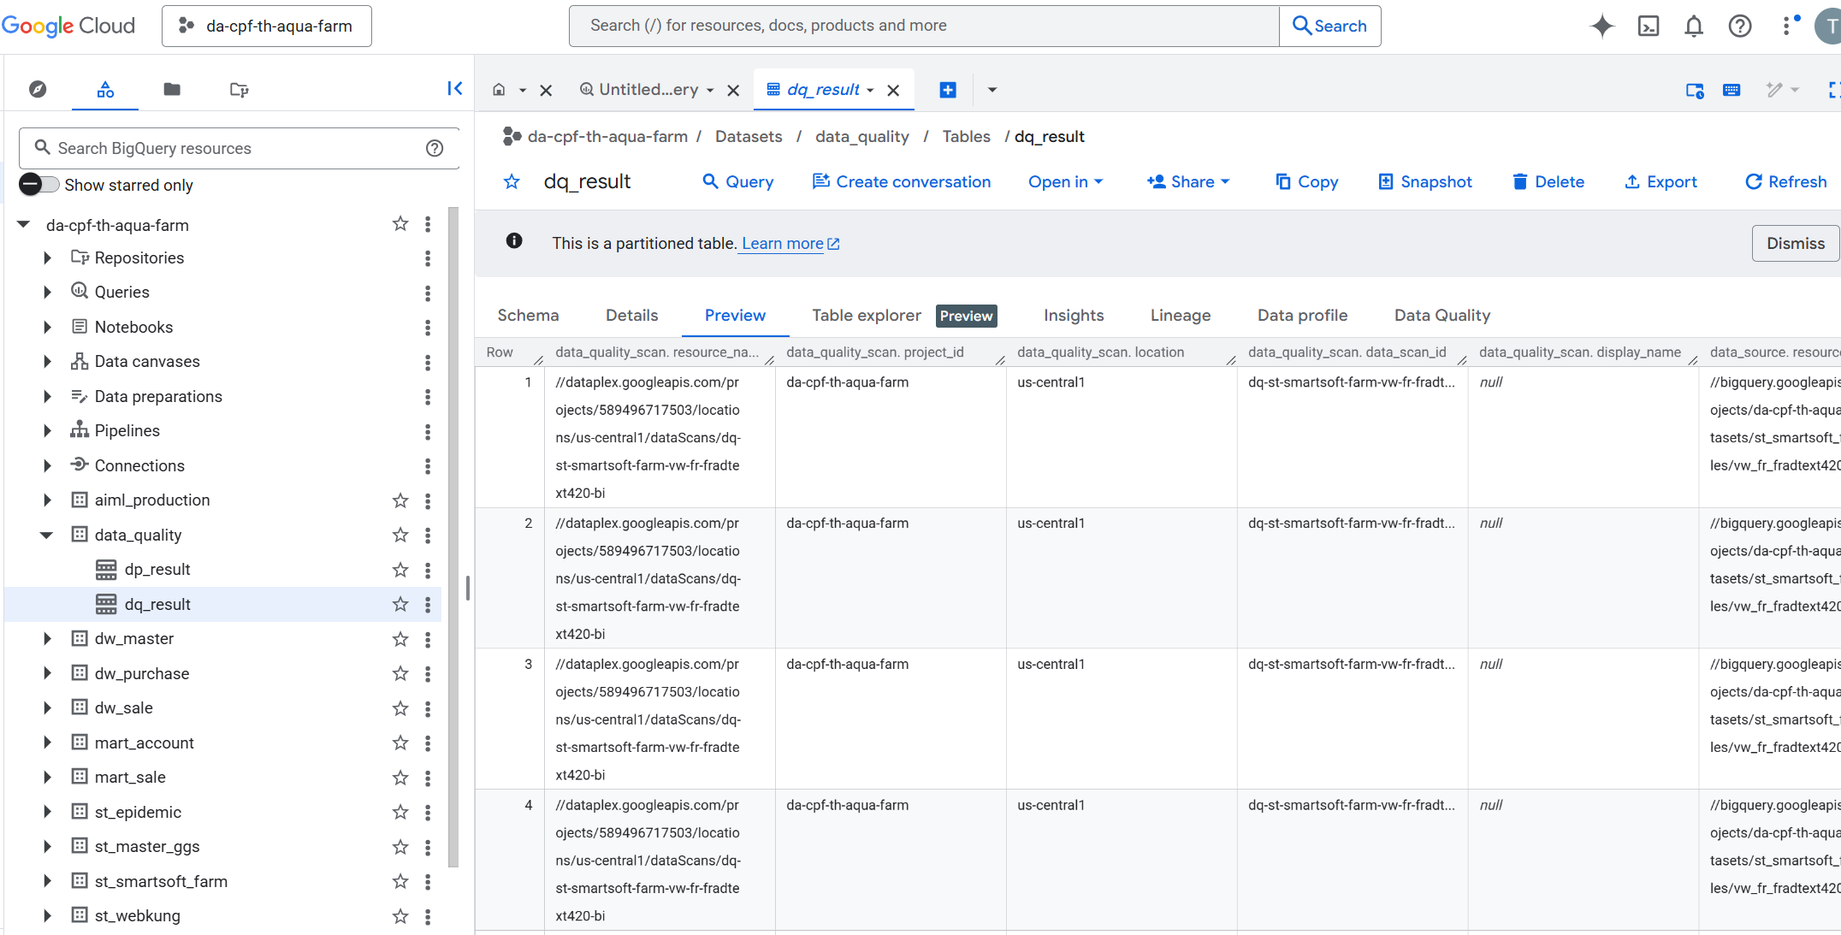
Project Data Quality
da-cpf-th-aqua-farm.data_quality.dq_result

Slide 2
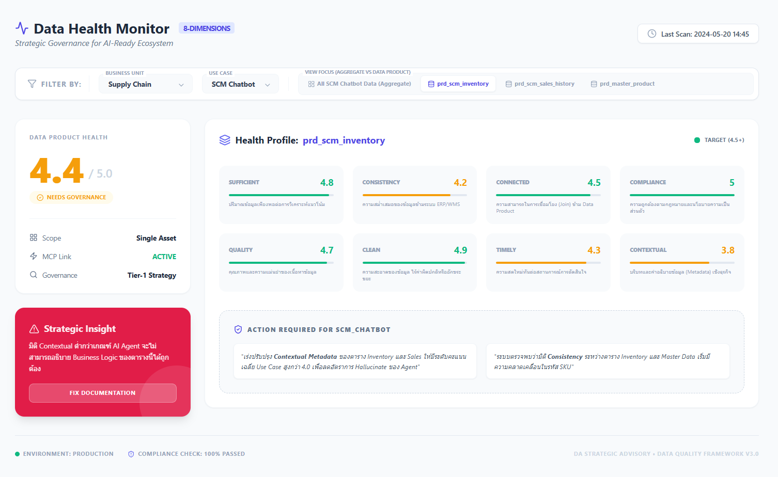
BU Data Score – Mockup Dashbord
https://gemini.google.com/share/e006e2dac6b9

